Slide 1
Augmented Reality Skills Training
FSI – Hack4Autism

Slide 2

Objective: Teach basic job skills to people with autism using Augmented Reality

Slide 3
PROBLEM
1 in 36
Children identified with autism spectrum disorder (ASD)
Who
5,437,988
5,437,989
5,437,990
5,437,991
Adults in United States have ASD
85%
US Unemployment Rate among people with ASD while having a College Education.
Why
160%
Increase in diagnoses of kids (4-year-olds) in 2016 vs 2012.
Notes:
according to estimates from CDC’s Autism and Developmental Disabilities Monitoring (ADDM) Network. -https://www.cdc.gov/mmwr/volumes/72/ss/ss7202a1.htm?s_cid=ss7202a1_w
Autism and Employment Statistics (Adults) - Update 2024 FSI Hackathon (mydisabilityjobs.com)

Slide 4
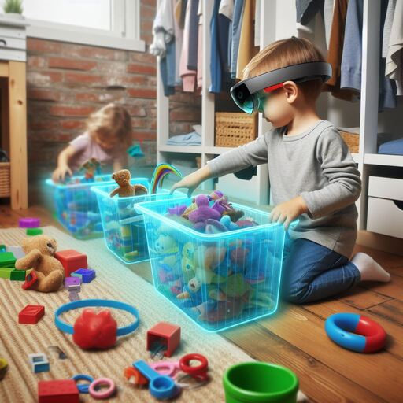
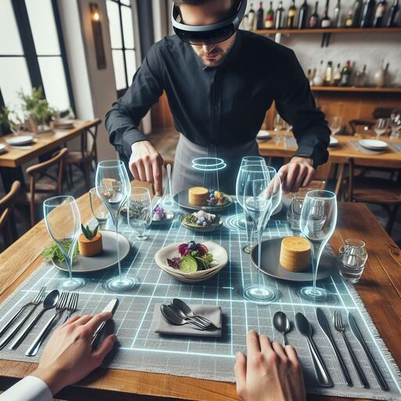
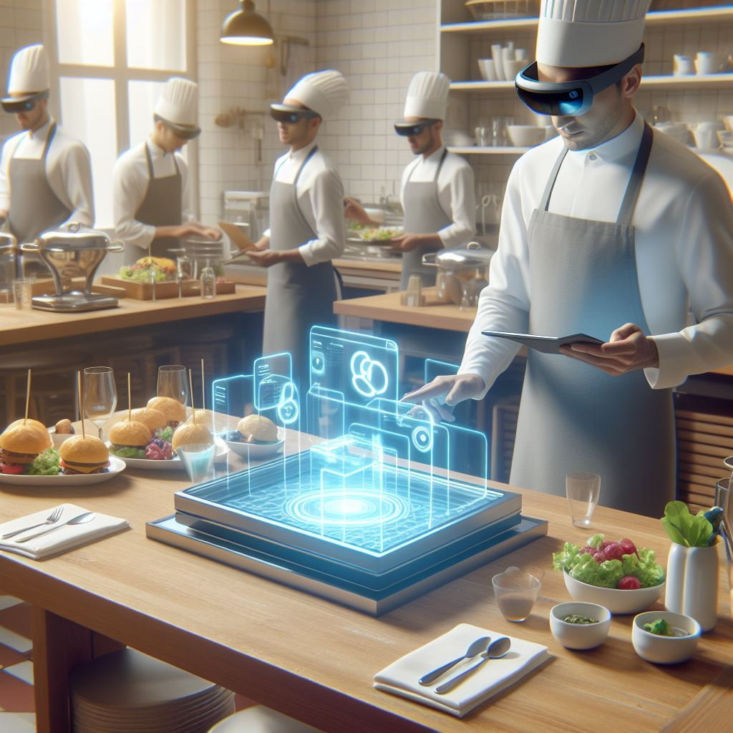
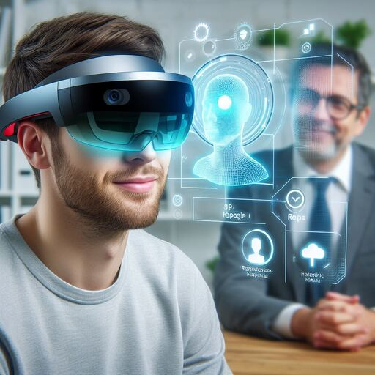
POTENTIAL USE CASES
Toddler stage changes
Setting up a table in a restaurant
Helping kids to practice changing between day stages (cleanup, putting away cutlery, finding their designated cubic, etc...
Making sure all the cutlery is there and properly arranged
Setting up a catering tray
Recognizing Emotional Response
Ensuring items are placed as per order
Assisting with and understanding social interactions

Slide 5
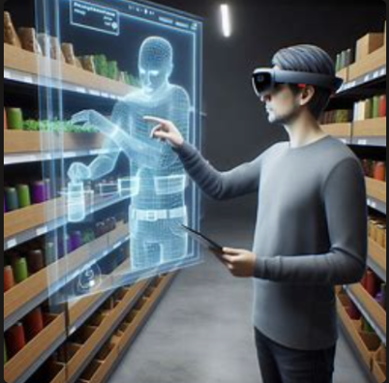

Stacking shelves in a store
Making sure items are placed in designated areas, visible and accessible
Reasons:
[+] Solution to Problem Statement
Use Case does provide potential solution by expediting upskilling and providing job opportunity
[+] VR is at a stage where this is viable
Connected, Clear, and accessible.
[+] AI can enhance recognition and provide recommendations
Utilize LLM to speed up recognition of and provide real-time feedback.
[+] Implementation can be a starter for the other use cases
Toddler Cleanup
Restaurant and Catering Assistance
[-] The emotional Response Use Case was too close to the Metaverse Social Practice use Case

Slide 6
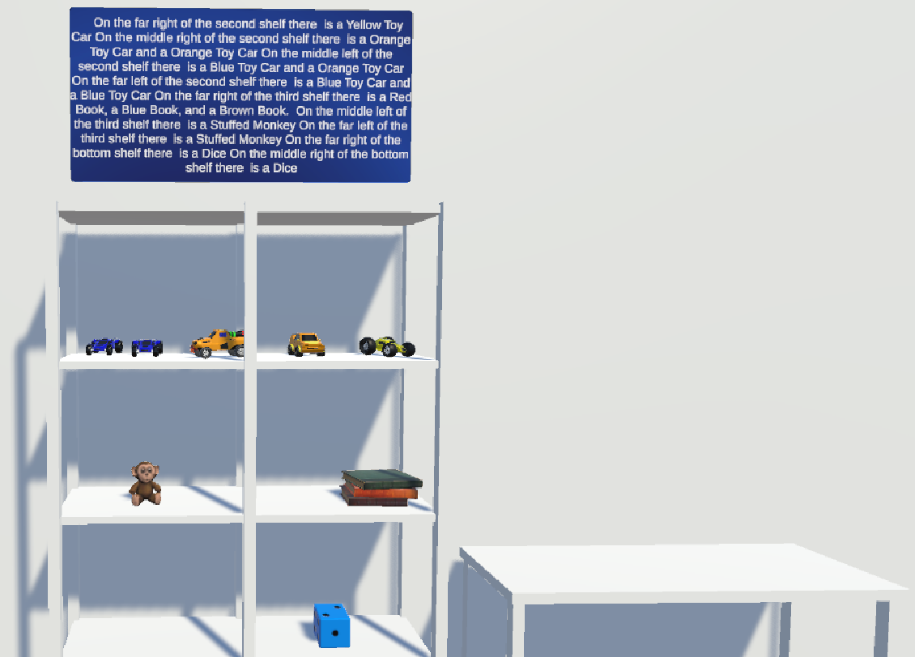
Beta version

Slide 7
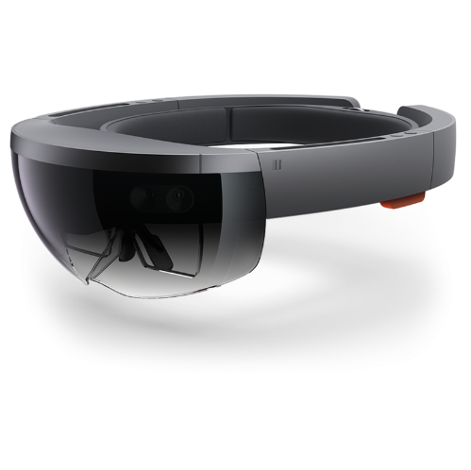


Architecture OVERVIEW
Recognizing real world items via match to assets in Unity
Feedback and numerical scoring of action
Microsoft HoloLens
Unity
v2022.3.23f1
User response/ Interaction with environment
Provides log of User's actions

Slide 8
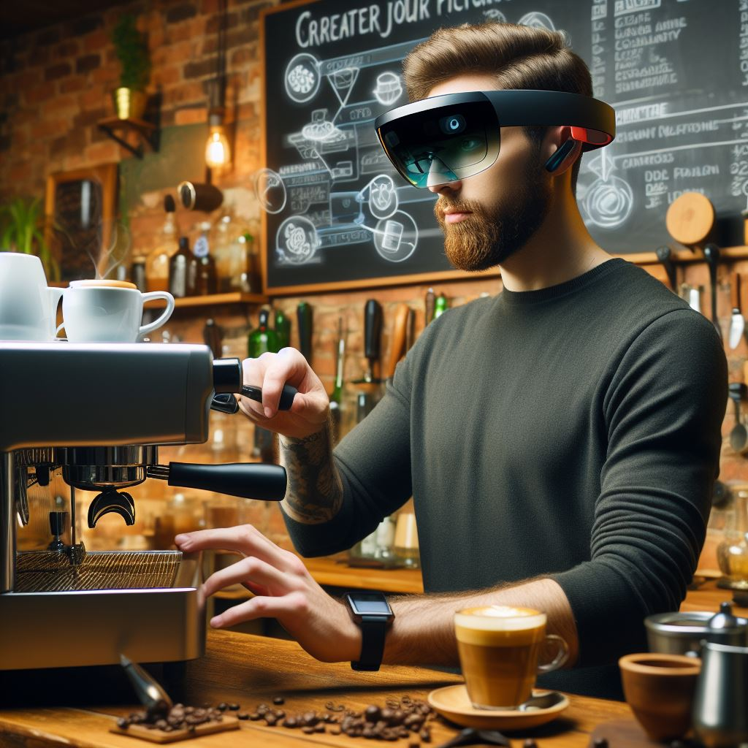

THE Future
Feature Enhancements:
XAPI2 – IEEE standard for correlating user experience behavior with business results
Storing results in the cloud to show progress
Record session data to analyze/generate progression metrics
Measure time taken per action
Personalizing Recommendations and creating a custom learning track
Enable voice recognition to assist
Emotional state recognition of the User to assist with social interaction
Expand to Further Use Cases
Generalize application to be able to sort and work with additional Assets
Toys - Cleanup (Toddler Use Case)
Kitchen Assets - Placement (Restaurant and Catering Use Case)

Slide 9








MEET THE TEAM
Peter Smulovics
Alexander Rakovshik
Amy Chen
Isha Mohan
Abbas Syed
Barry Cordie
Cynthia Sabbagh
Matthew Fairfax

Slide 10
THANK YOU
Holodeck Team 2024 Hack4Autism

Slide 11
SUMMARY
At Contoso, we believe in giving 110%. By using our next-generation data architecture, we help organizations virtually manage agile workflows. We thrive because of our market knowledge and great team behind our product. As our CEO says, "Efficiencies will come from proactively transforming how we do business.”

